Slide 1
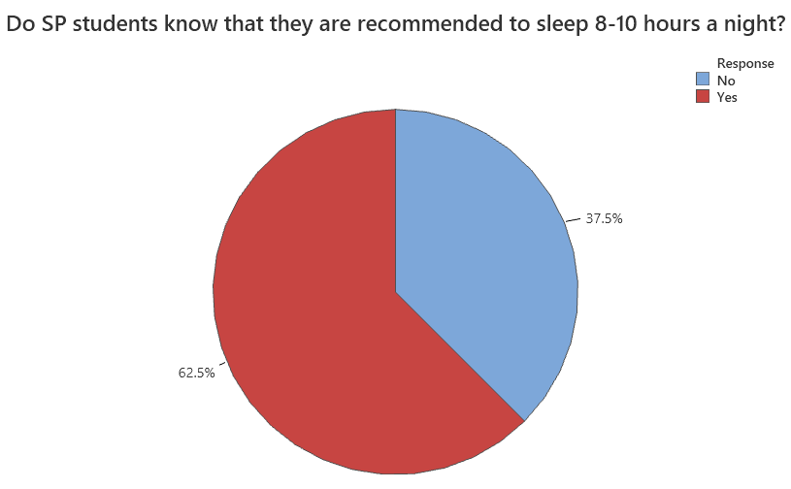
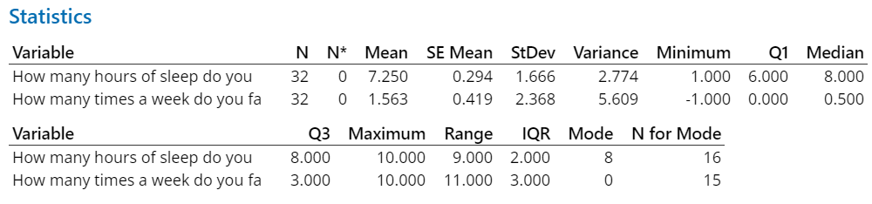
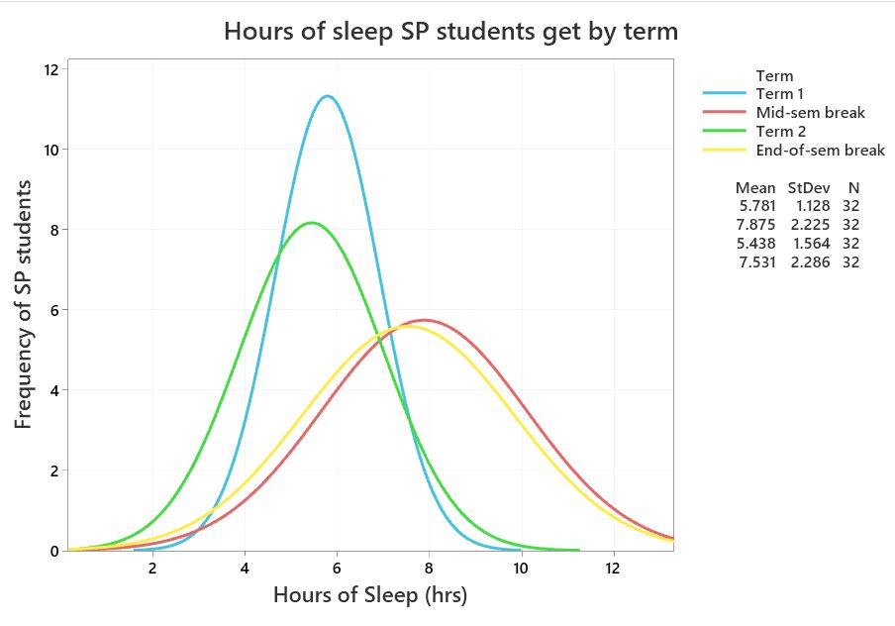
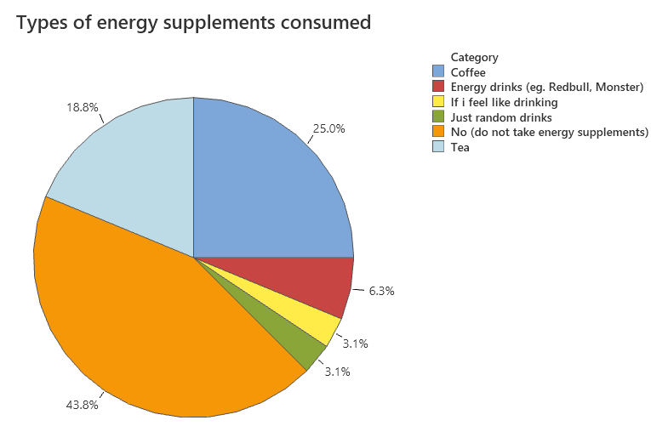
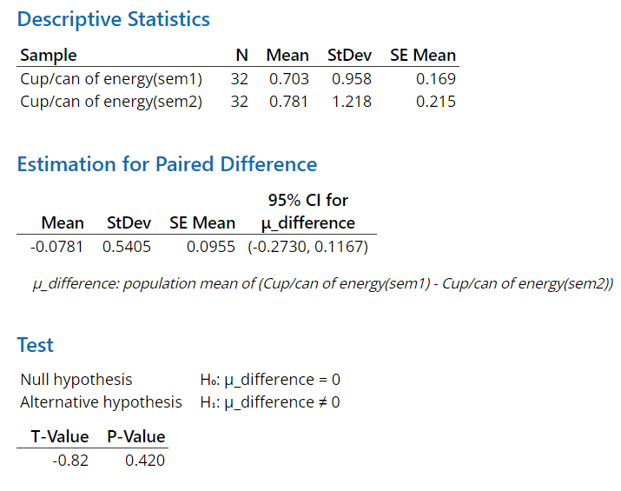
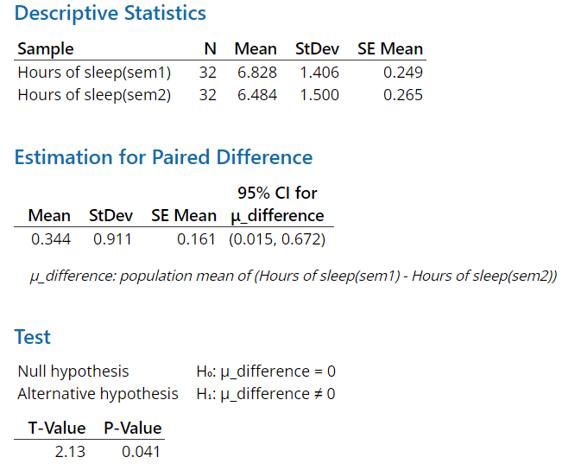
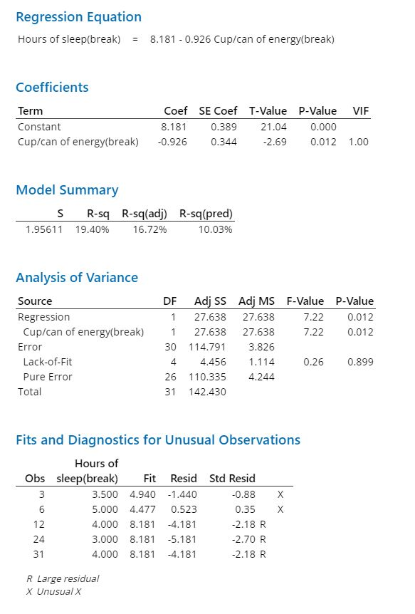
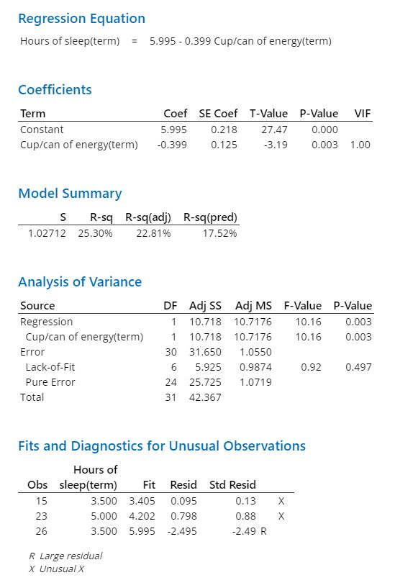
Background info:
The question of whether Singapore Polytechnic (SP) students are getting enough rest arises as assignments approach. With a recommended 8-10 hours of sleep per night, it is unclear if SP students are sacrificing sleep for academic pursuits or maintaining healthy sleep habits. The variation of sleep patterns and habits throughout the academic year is also unknown.
How much sleep do SP students get during different parts of the year?
Hypothesis 2
Term
H0: slope(term) = 0
H1: slope(term) =/= 0
Output: t = -3.19, d.f. = 32 - 2 = 30, P-value = 0.003
Interpret: P-value = 0.003 < 0.05, reject H0
Since H0 is rejected, we conclude that there is a significant linear relationship between the number of cups/cans of energy supplements SP students consumed and the number of hours of sleep they get in the terms.
Break
H0: slope(break) = 0
H1: slope(break) =/= 0
Output: t = -2.69, d.f. = 32 - 2 = 30, P-value = 0.012
Interpret: P-value = 0.012 < 0.05, reject H0
Since H0 is rejected, we conclude that there is a significant linear relationship between the number of cups/cans of energy supplement SP students consumed and the number of hours of sleep they get during the breaks.
Now that we have our findings, let us see in which of the two linear relationships has the best quality of fit.
To do this, we will be comparing the correlation coefficient, r^2, of each of the two:
Terms: r^2 = 25.30%
Breaks: r^2 = 19.40%
As the correlation coefficient of the terms is higher, the terms has the better quality of fit of its regression model as compared to the breaks.
Descriptive statistics and graphical summaries
Conclusion
In conclusion, there is a significant relationship between the number of cups/ cans of energy supplement, and the number of hours of sleep that SP students receive. However, we are surprised to find out that most SP students do not consume energy supplements which is shown by the pie chart and r^2 value in hypothesis test 2.
We can also conclude that there is a relationship between the time of the year (Term 1/ Term 2) and the number of hours of sleep. We can see that during Terms, students sleep less. Whilst during breaks, students receive more sleep.
However, we do not have enough evidence to show that there is a relationship between the time of the year (Term 1/ Term 2) and caffeine intake.
Data
The data was collected through a survey which asked questions about the behavior patterns of Singapore Polytechnic (SP) students at different times of the year, including their caffeine consumption in different terms and breaks:
How many hours of sleep do you think you need?
How many times a week do you fall asleep in class?
Do you feel like you can concentrate in class
Do you take any energy supplements? If yes, what?
How many cups/ cans of energy supplements do you take?
How many hours of sleep do you get?
Hypothesis test 1
Energy supplement
Hours of sleep
Hypothesis test 2
Break
Term
Graphical Summaries
The table summarizes the sleep habits of Singapore Polytechnic (SP) students. The average number of hours of sleep that SP students need is 7.25 hours, slightly lower than the CDC's recommended 8-10 hours. The median of 8 hours aligns with the recommended amount. The mean for the number of times SP students fall asleep in class is 1.56, indicating that each student falls asleep in class at least once a week. 62.5% of the respondents know that 8-10 hours of sleep is recommended. During breaks, the average hours of sleep is higher than during term time but with a wider spread. 43.8% of SP students do not consume energy supplements, with coffee being the most popular at 25%.
Hypothesis test 1
The first t-test will examine the difference in the mean amount of caffeine consumed, while the second will examine the difference in the mean amount of sleep consumed. The null hypothesis for both tests is that there is no change in the amount consumed (mean = 0).
The alternative hypothesis is that there is a change (mean ≠ 0).
For both tests, a two-tailed test will be used. The output for the caffeine test shows a test statistic of -0.82, a P-value of 0.420, and a 95% confidence interval of (-0.2730, 0.1167). The interpretation of the results is that the P-value of 0.420 is greater than 0.05, meaning it is not rare to obtain a sample mean difference of -0.0781. Additionally, the test statistic is not in the critical region (-2.040, 2.040) and the confidence interval includes the hypothesized mean difference of 0. Thus, we do not reject the null hypothesis and conclude that there is no change in the amount of caffeine consumed between term 1 and term 2.
The output for the sleep test shows a test statistic of 2.13, a P-value of 0.041, and a 95% confidence interval of (0.015, 0.672). The interpretation of the results is that the P-value of 0.041 is less than 0.05, meaning it is rare to obtain a sample mean difference of 0.344. Additionally, the test statistic is in the critical region (-2.040, 2.040) and the confidence interval does not include the hypothesized mean difference of 0. Thus, we reject the null hypothesis and conclude that there is a change in the amount of sleep the SP students get between term 1 and term 2.

